Slide 1

Alpha Alloy
Code Gladiators Blockchain Challenge
Hari Santhosh V
Shankaranarayanan K R

Slide 2

Vision
Micro Lending Platform

Slide 3
Objectives
1.The primary aim of this proposal is to advocate for a democratized platform for money lending thereby people can benefit without paying for intermediaries.
2.A peer-to-peer transaction system where lenders can directly send their money to borrowers.
3. A Free open Marketplace where lenders state their proposal and borrowers can find the deal of their choice, thereby creating a healthy ecosystem for trading with no unfair practices

Slide 4
Objectives
4.Transactions and Credit History will be logged appropriately in the digital ledger thereby providing full visibility for both the parties involved
5.Borrowers from remote villages can access the platform from their Feature Phones thereby breaking down the reliability of Smart Phones, as the platform can be invoked as a service from SMS, and gather access to the Open Market
6.A complete visibility on the borrowers track record and their validators (or backers) who have issued previous loans to them and carried out transactions successfully.

Slide 5

Problem statement, solved!
Our business suite includes Ethereum Blockchain which logs all the transactions and creates a healthy ecosystem of Micro lending platform for anyone and everyone.

Slide 6
Why us?
We don’t just felicitate direct peer to peer transactions between borrowers and lenders but also tracks the journey of the money / value so that lenders can keep tabs on the money spent for various transactions.
We don’t do formal background checks but rather the platform becomes the testament for the user requesting money with his previous clean record which builds trust intrinsically
Reward Lenders who also become validators by vouching for the borrowers, by splitting the Interest generated by the borrowers current loan, encouraging them to use our platform for Micro-Lending

Slide 7
3 Step
Loan Disbursal
Sign up to the platform
State your proposal and the amount required
Sign the contract and get the money in your wallet

Slide 8
Decentralized Cross Platform Application
We have developed a decentralized cross platform application whose workflow is as as shown:
Lender and borrower sign up with their Aadhar Id and can start interacting seamlessly
The Marketplace is for lenders to look out for borrowers whose profile is listed along with the validators backing them who once transacted directly with them
The Lender will reach out to the Borrower and propose their norms, and upon consenting by both parties a digital contract will be signed and the tokens will be disbursed into the borrowers waller
The tokens can be any micro-currency running on top of Ethereum, also during rollouts exclusive currency backed by governments like LakshmiCoin or JIOCoin can be made the de-facto trading tokens.

Slide 9
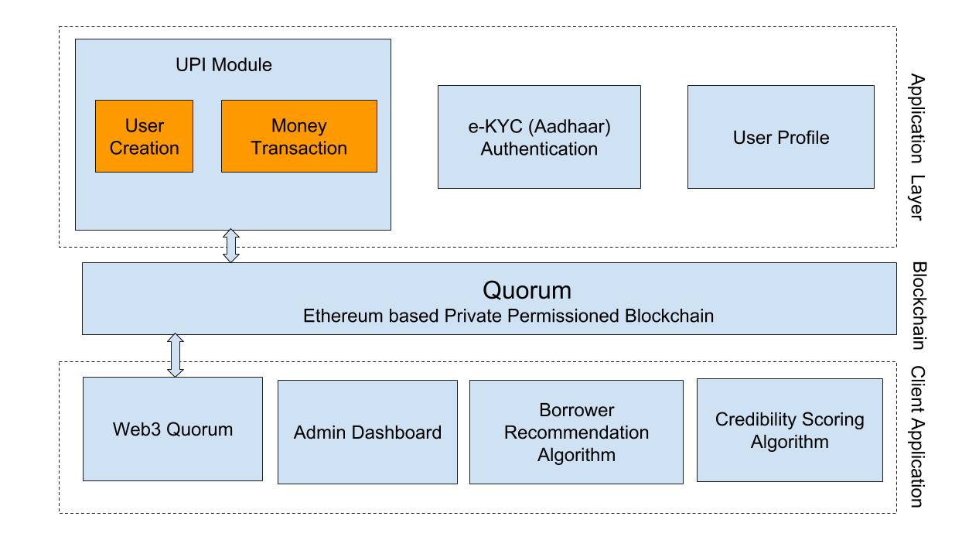
Architecture

Slide 10
Architecture Explained
The architecture is designed with heavy emphasis on keeping the application completely decentralized
The client side application can be of any form (Web App/ Android /iOS App / Mobile Phone), thereby making the solution universal and cross-platform
The digital contract and the history of transactions are stored in Ethereum Blockchain, with smart contract written in Solidity
Tokens can be converted to fiat currency by redirecting to a secure exchange center platform like CoinBase and ZebPay or a future exchange which will be backed by the Government of India
Other than the micropayments recorded in the transactions, all user details and their affiliated documents are stored in IPFS (Inter Planetary File System), using Oraclize we can validate feeds from the external world and build Intelligent Systems to provide Analytics support

Slide 11
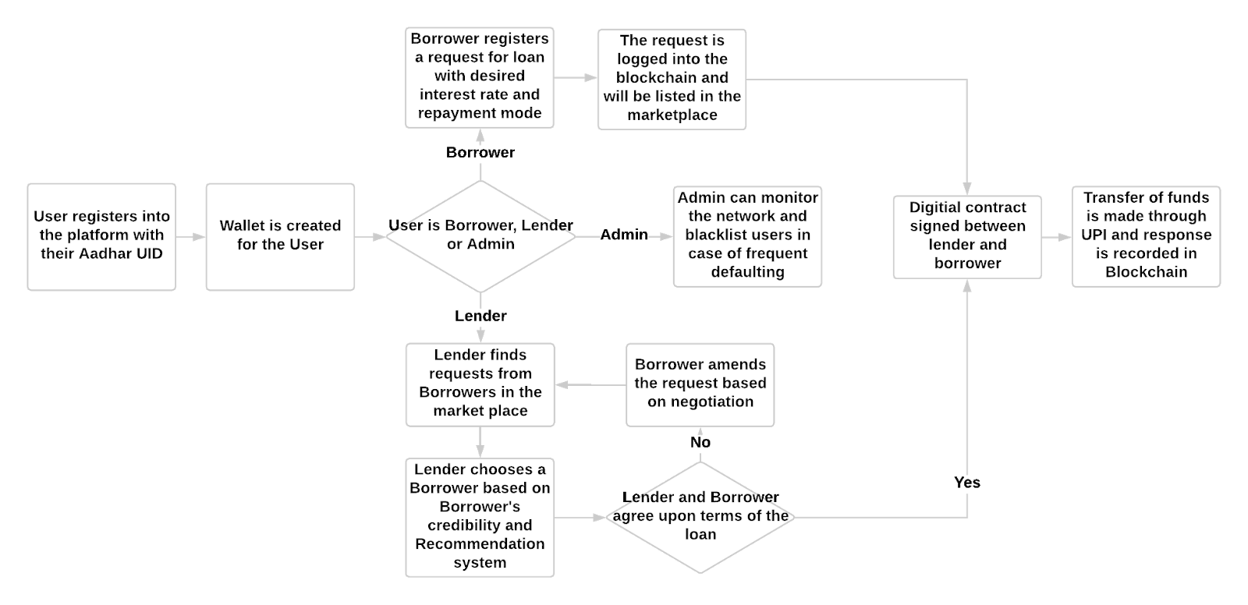
Application Flow

Slide 12
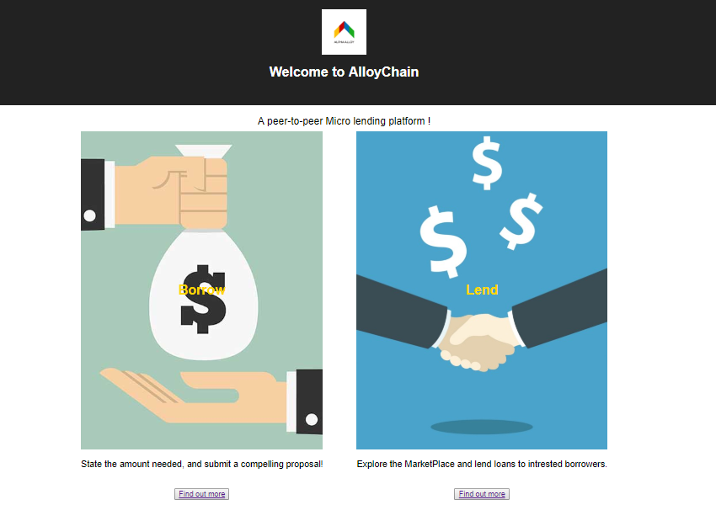
AlloyChain

Slide 13
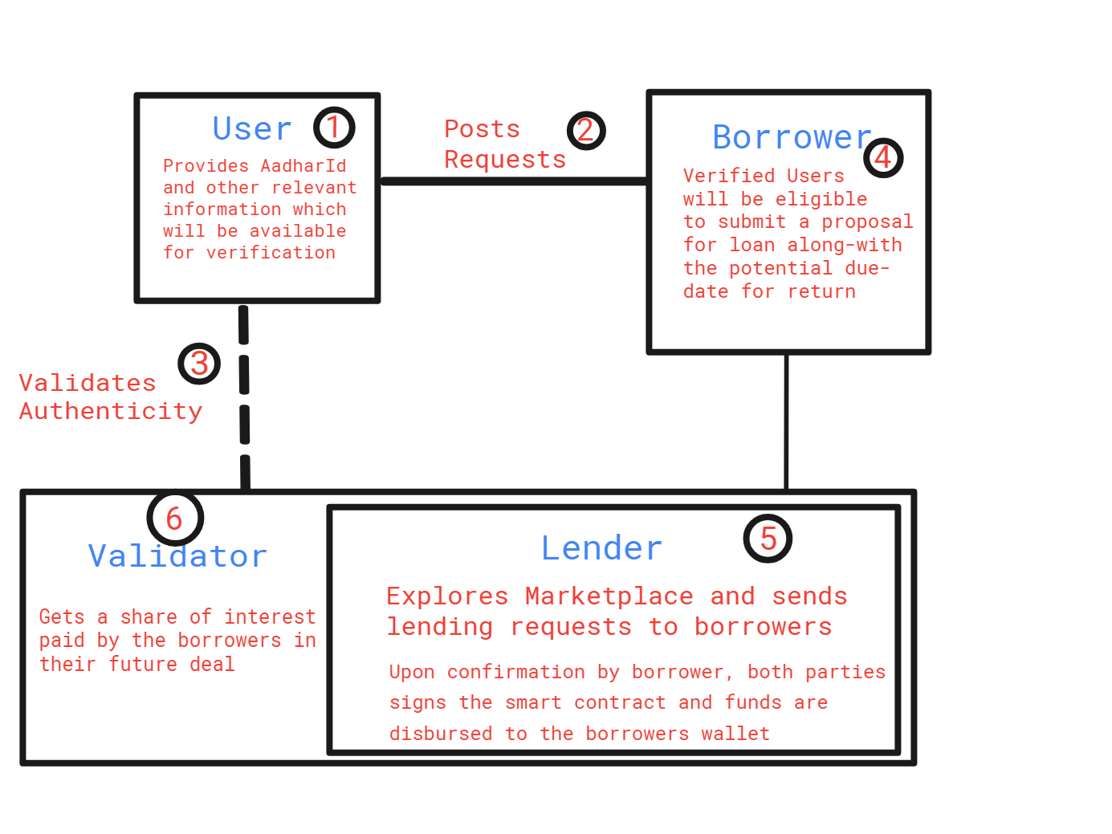
Smart Contract Architecture

Slide 14
Smart Contract Explained
Users are on boarded into the platform by listing their Aadhar Id and other valid credentials for verification
The Users who want to borrow money posts their requests
The Validators are the lenders who have previously engaged in transactions with the borrower and give a heads-up if they deemed the borrower as an eligible nominee who can pay back the loan in the stipulated time zone. If a lender becomes a validator for a nominee he will be incentivized with tokens on the future interest generated by the borrower’s loan

Slide 15
Smart Contract Explained
4. The loan request will be listed in the Marketplace with the borrower’s history of transactions and the number of supporting validators
5. The Lender can find the suitable match in the Marketplace and send a Transaction request to the borrower. When agreed by both parties, they sign a mutual digital contract and the deal is sealed
6. After the transaction is complete and the repayment is made, the Validators get paid in Tokens for providing Proof Of Authenticity, in case of default by borrowers the validators take shared responsibility in returning the debts to the Lender

Slide 16
AI is in the house
Recommendation System
A system that recommends borrowers to lenders considering several factors to predict the chances of prompt repayment of loan.
It takes into account:
Proposal sentiment
Current trends in line of business
Environmental factors
Seasonal elements
The system consists of a neural network which predicts the probability of repayment trained on archived loan data
BI tools can be leveraged to bring meaningful insights on Borrower’s profile
Credibility Scoring
An algorithm that scores both the lender and the borrower based on past transactions transacted in the network.
This provides complete visibility in the transaction pipeline thereby providing transparency in the system
It takes into account:
Prompt repayments
Defaults, if any
Transparency in the contract
Transactions in blockchain are provided on a as-is basis to the lender.
Misleading judgement towards any borrower is avoided

Slide 17
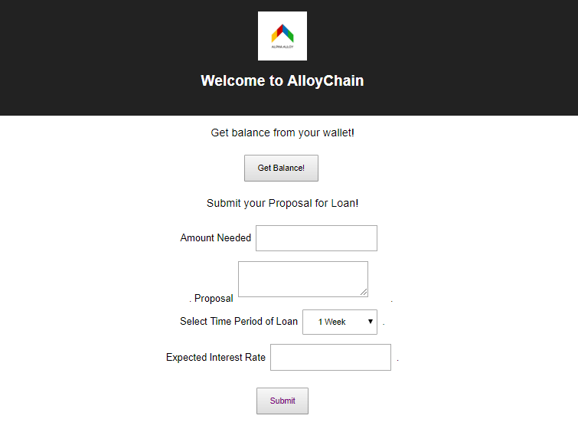
Request Loan

Slide 18
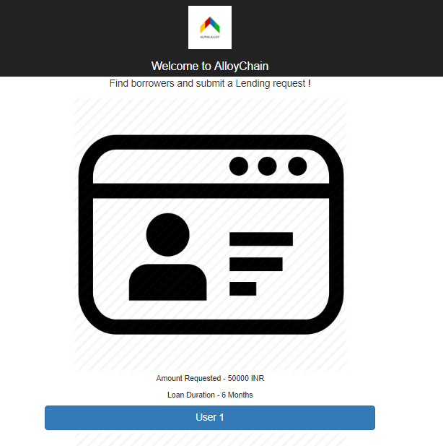
MarketPlace for Lenders

Slide 19
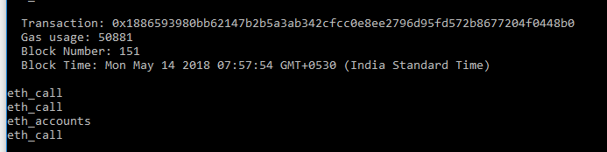
Transactions logged in Blockchain
All the mined blocks and the transactions are duly logged in the blockchain

Slide 20
Highlights and Key Performance Indicators (KPI’S)
We have built a true decentralized platform
No Verifications made in a centralized manner (No External Calls to interact with a third party server) as it leads to partial centralization
Only Lenders can be validators who upon successful transactions will be given benefits on the interests rate of the loan
We understand the value of Mining a block, hence contracts are not built with expensive loops and validations, rather it’s a seamless system with works right out of the box
The platform is immune to counterfeiting as it churns out unvalidated user accounts, which will be easily identified by the lenders who avoid dealing with them

Slide 21





Tech Stack
Solidity
Truffle
Quorum
ReactJS
BootStrap
The de-facto language of programming Smart contracts in Ethereum
Used to build and deploy, Smart Contracts in TestRPC Blockchain
A Private Permissioned peer to peer blockchain network based on Ethereum
Most popular and powerful Client Side MVC Framework supported and maintained by Facebook
Build Responsive and composable Stylings to complement ReactJS components

Slide 22
Summarizing
Seamless Peer to Peer
Micro-payments
Decentralized shared responsibility Model
Remote Access with feature phones
Building a robust system for micro-payments which is Decentralized and transparent and is also interoperable with different clients.

Slide 23
Demo
Demo video is attached with the submission

